Slide 1
Fast Food and Obesity
Julia Catalano, Anne Good, Nicole Lepley

Slide 2
Motivation & Summary - Anne
Motivations: We were curious to know if the number of fast food restaurants have an impact on obesity rates.
Hypothesis: The states with a higher number of fast food restaurants will have a higher obesity rate
Null Hypothesis: The number of fast food restaurants in a state has no impact on obesity rate in the state

Slide 3
Questions & Data - Nicole
Does a higher number of fast-food restaurants impact obesity rates?
number of fast food restaurants per city and obesity rate per city
Kaggle and CDC
Do the number of healthy options impact obesity rates?
The healthy options were too challenging based on our dataset. The heat map visualizes the concentration of fast food places in the US.
Is there a correlation between population density and the number of fast-food restaurants?
city population per city and number of fast food restaurants per city
Census API and Kaggle

Slide 4
Data Cleanup & Exploration - Julia
Data Sources
Clean
Combine
Used Census API to import population data for the United States
Fast food restaurant locations across the United States CSV file
Obesity rates by state CSV file
Remove duplicate fast food restaurants with the same name and address
Convert state codes to states
Format column titles for all data sets to match
Merge all data sets by state
Drop incorrect data

Slide 5
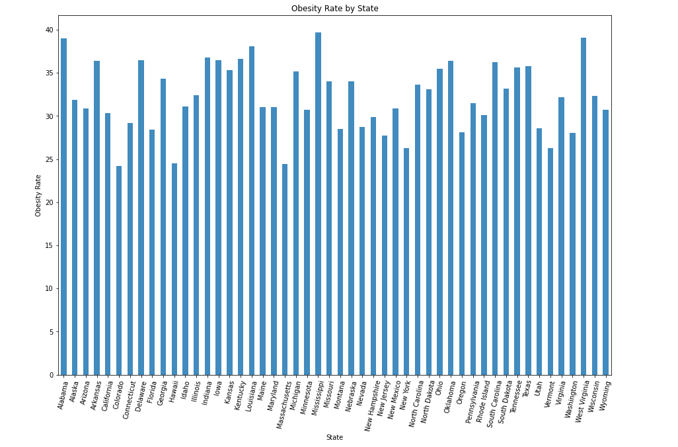
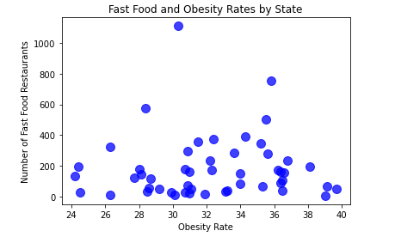
Data Analysis - Fast Food Count by State and Obesity Rate

Slide 6
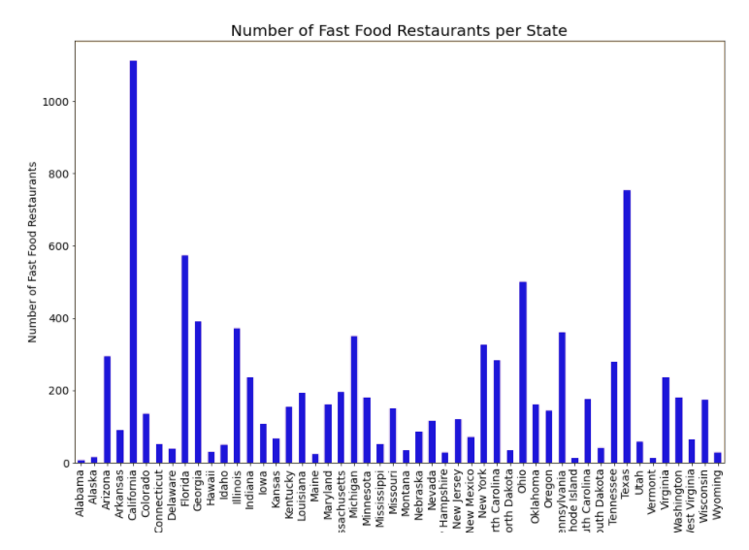
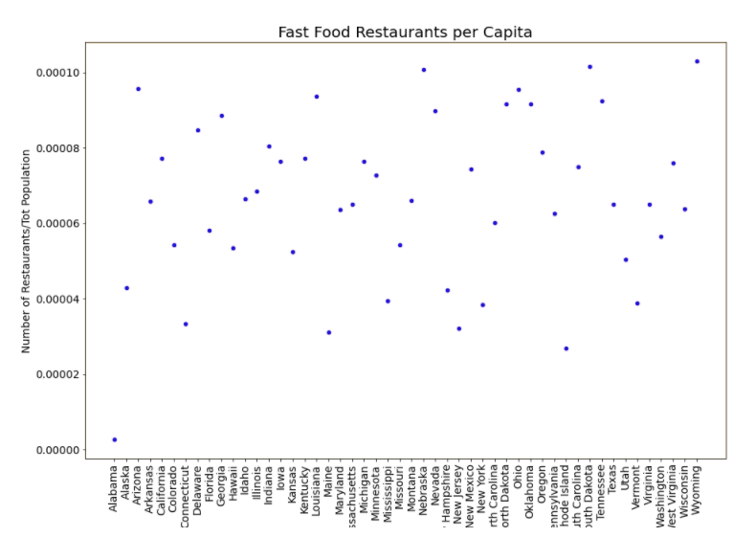
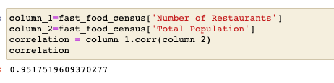
Data Analysis - Fast Food per Capita

Slide 7
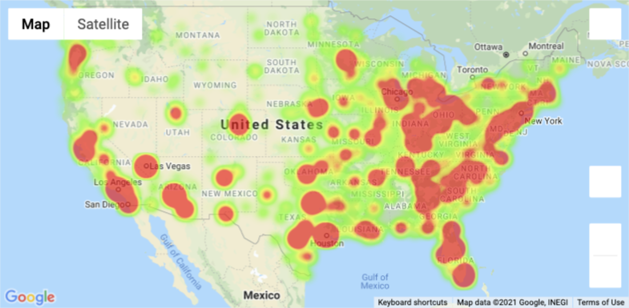
Data Analysis - Anne
Heat map of Fast Food Restaurants in the US

Slide 8
Findings – Fail to Reject Null Hypothesis - Anne
Hypothesis: The states with a higher number of fast food restaurants will have a higher obesity rate
Null Hypothesis: The number of fast food restaurants in a state has no impact on obesity rate in the state
Process for testing:
Independent Variable = Fast Food count
Dependent Variable = Obesity Rate
Test: Anova
We sorted our data by our independent variable and created three groups:
High number of fast food places, medium number of fast food places, lower number of fast food places
pvalue = 0.71
Conclusion: Since 0.71 is NOT < 0.05, we failed to reject the null hypothesis

Slide 9
Post Mortem - Nicole
Discuss any difficulties that arose, and how you dealt with them
Data set not complete – missing total number of fast food restaurants per state
Merging issues
Discuss any additional questions that came up, but which you didn't have time to answer: What would you research next, if you had two more weeks?
Obesity rates compared to poverty levels
If there is a difference in “healthy” fast food vs “unhealthy” fast food

Slide 10

Questions

